Slide 1

Thomas Stoyles
2312447

Slide 2
PID controller
Used front right and front sensors
This was so that we could see the right side as that is all we needed to see when following the wall.
To tune the values I ran multiple tests on different kp, ki and kd values until I found the ones that worked best for me

Slide 3
Fuzzy – Right edge
I used front right, back right and the front sensor this was so the robot could see the right wall it was following
The input membership functions are defined with a bunch of IF statements. These are split into front distance, back distance and front. Within these IF statements we state all of the rules for that sensor which also let us know where on the graph it is.

Slide 4
Fuzzy – Right edge
I used dictionaries for the rule base, with near, medium and far values. In the code it is a nested dictionary but that was so I could upgrade it to obstacle avoidance.
The output membership functions are not explicitly defined however they are within the rule set which is also used for the input membership functions. They are the selected function at the end of the calculate movement() function. These values are passed to the msg.linear.x and the msg.angular.z functions which tells the robot how far to move

Slide 5
Fuzzy – Obstacle Avoidance
I used front right, back right, front and left sensor this was so the robot could see the right wall it was following and the left walls so it could move away from them when it got to close
The input membership functions are defined with a bunch of IF statements. These are split into front distance, back distance and front. Within these IF statements we state all the rules for that sensor which also let us know where on the graph it is.

Slide 6
Fuzzy – Obstacle Avoidance
I used nested dictionaries for the rule base, with near, medium and far values. Then within these options will be another subset of near, medium and far values. In which they have the speeds in which the robot will move at. E.g. (Slow, left)
The output membership functions are not explicitly defined however they are within the rule set which is also used for the input membership functions. They are the selected function at the end of the calculate movement() function. These values are passed to the msg.linear.x and the msg.angular.z functions which tells the robot how far to move

Slide 7
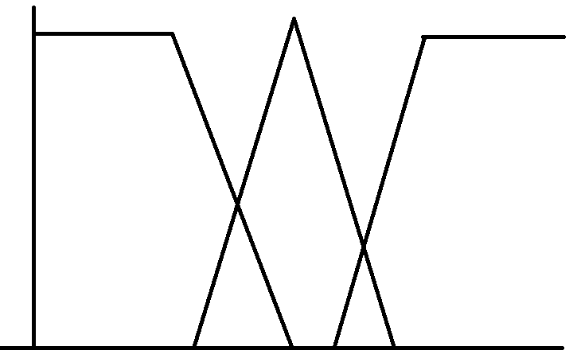
Fuzzy logic – Input graph(Sensors)

Slide 8
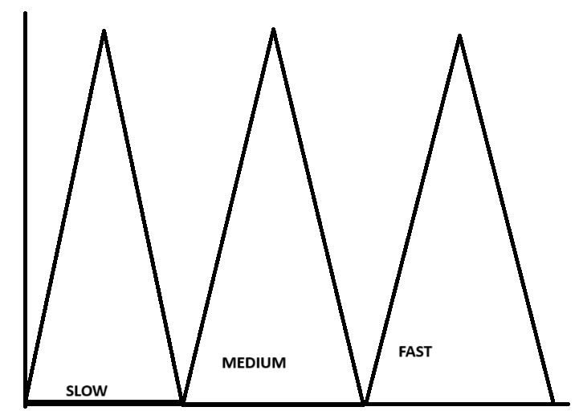
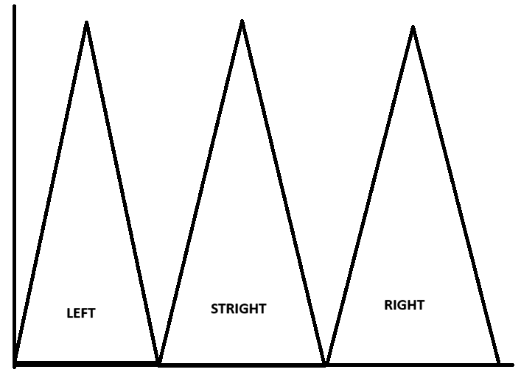
Fuzzy logic – Output graph(linear and angular speeds)

Slide 9
Overview
Firstly, we define the memberships using the distances, linear speed and angular speeds
Then we define the rule set using the nested dictionary we use near, medium and far
We then calculate the membership function using if statements for example if front right sensor is near the it will equal 1.
We then calculate the robots movement based on the previously defined fuzzy logic.

Slide 10
Thanks for listening

